Slide 1



Slide 2

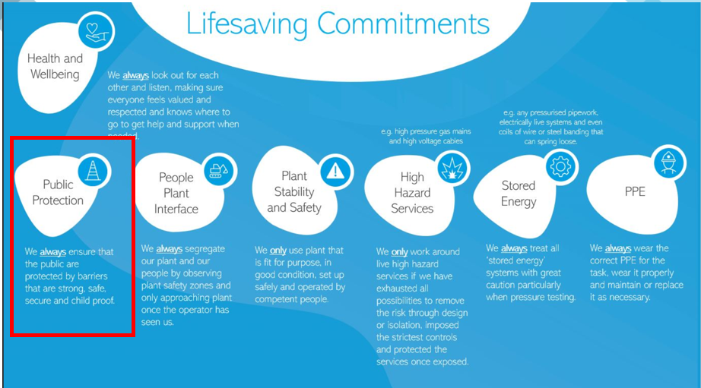
Introduction
Thames Water and its Partner Organisations carry out thousands of activities each year such as construction, tankering and deliveries. Hazards associated with these activities can cause risks not only to people working on our sites. In the UK every year, children and other members of the public are killed or injured by work activities that are not adequately controlled.
There are many occasions, especially during network operations, where construction sites are exposed to high risk areas such as public highways. It is imperative that members of the public and the workforce are both provided with suitable protection in line with the requirements of Safety at Street Works and Road Works code of practice and Essential Standard 16 Street Works
Hazards that cause
Risk to the public
Management of Site Access
Vulnerable Groups

Slide 3
Task – Control of Hazards
The following 3 slides are split into two parts which are depicted in red;
Slides for Office Based Personnel
Slides for Site Based Personnel
Carry out one of the two tasks based on what is relevant to your role.
Hazards that cause
Risk to the public
Management of Site Access
Vulnerable Groups

Slide 4
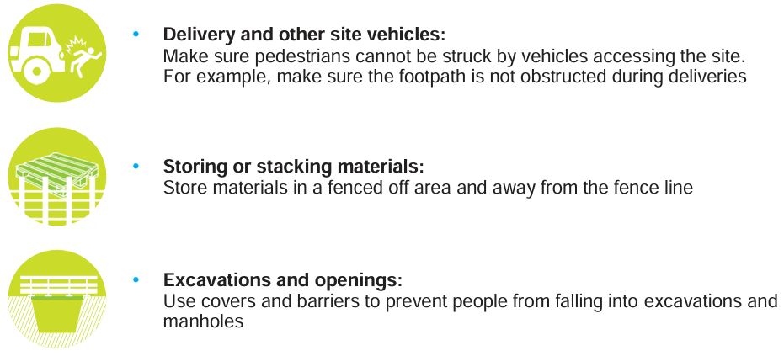
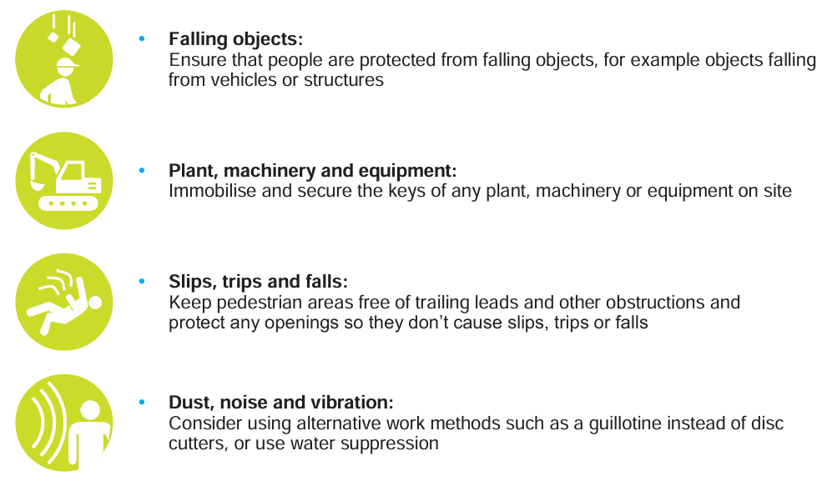
Control of Hazards that cause Risk to the Public - Office Staff
TASK – When visiting the office, in line with situational awareness principals (see end slide for details). review the following factors. Where issues are found, please log a Safety Observation (Change to include contractor system). Consider Vulnerable Groups that may be present in the area e.g. local schools, popular public transport routes, care homes etc.
Hazards that cause
Risk to the public
Vehicles – Reverse parking at all times? Any tailgating to site?
Slips, Trips and Falls – ensure pedestrian routes are free from trailing leads and other obstructions. Good visual image and housekeeping?
Site Conditions – Are there are TW sites within the proximity of the offices. If so, review for public protection controls ( materials barriered off, site secure, no trip hazards)
Personnel Identification – Are all personnel wearing ID badges (visitor or staff)
Vulnerable Groups

Slide 5
Control of Hazards that cause Risk to the Public
TASK – Walk the site in line with situational awareness principals (see end slide for details) and review the following factors. Where issues are found, please log a Safety Observation (Change to include contractor system). Consider Vulnerable Groups that may be present in the area e.g. local schools, popular public transport routes, care homes etc.
Hazards that cause
Risk to the public
Site Vehicles – Implement measures to ensure pedestrians cannot be struck be site vehicles. Ensure there is a suitable footpath at all times and means of segregating the public from site vehicles
Material Storage – ensure materials are barriered off and away from the fence line. Ensure they are stacked properly to prevent them toppling over.
Excavations & Openings – ensure all excavations and openings are barriered off and where possible use covers to prevent a fall
Falling Objects – consider the risk of falling objects and put measures in place to protect people from this e.g materials falling off a scaffold or a vehicle
Vulnerable Groups

Slide 6

Control of Hazards that cause Risk to the Public
TASK – Walk the site in line with situational awareness principals (see end slide for details) and review the following factors. Where issues are found, please log a Safety Observation (Change to include contractor system). Consider Vulnerable Groups that may be present in the area e.g. local schools, popular public transport routes, care homes etc.
Hazards that cause
Risk to the public
Plant, Machinery and Equipment – immobilise and secure the keys of all plant and equipment onsite. Ensure it is secured away when not in use, during breaks and at the end of shift
Slips, Trips and Falls – ensure pedestrian routes are free from trailing leads and other obstructions
Dust, Noise & Vibration – Consider other methods which reduce nuisance and implement measures such as acoustic barriers and water suppression where required.
Access – Remove all ladder from excavations and scaffold and chain up if left onsite
Hazardous Substances – Lock away in COSHH store when not in use and at end of each day
Vulnerable Groups

Slide 7
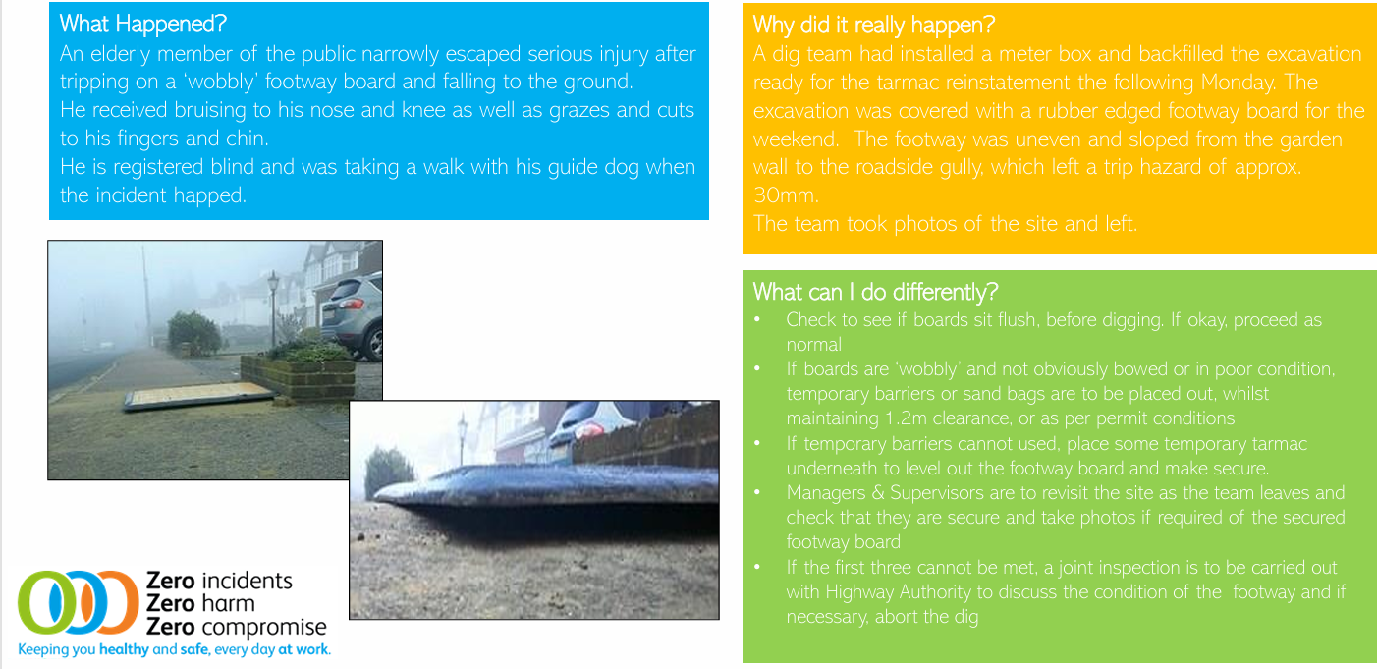
Learning Bulletin – MoP – Cuts & Bruises from falling over

Slide 8
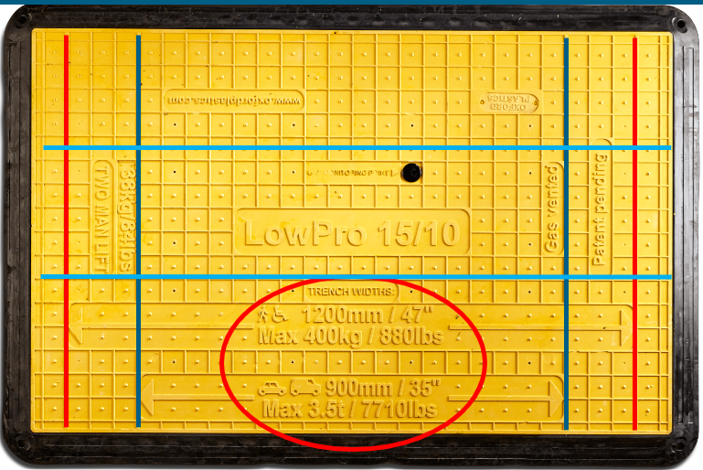
Footway Board - Placement
The purpose of a footway board is to allow the footpath/areas to remain open when we are not working in the excavations​
​
But like anything they only work on the right excavation, choosing the wrong board could have implications for the members of the public (MOP) or our colleague that need to use the areas
Hazards that cause
Risk to the public
Example – Oxford Plastics 15/10 Board
The markings denote the trench width it can be used for;
Red=pedestrian only 1200mm/47”wide (look for the arrows on the board)​
Dark Blue=can be used across driveways (note max loadings)​ 900mm/35”​
​
Light Blue= trench width 400mm lengthways
Trench MUST NOT extend beyond the arrows on the board

Slide 9
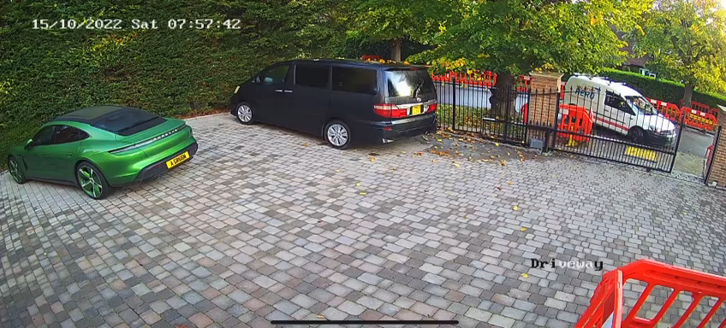
Control of Hazards
Non- Thames Water Job - Failure to use suitable equipment ( Adequately sized footway board), causing a van to partially end up in an excavation.
Management of Site Access

Slide 10
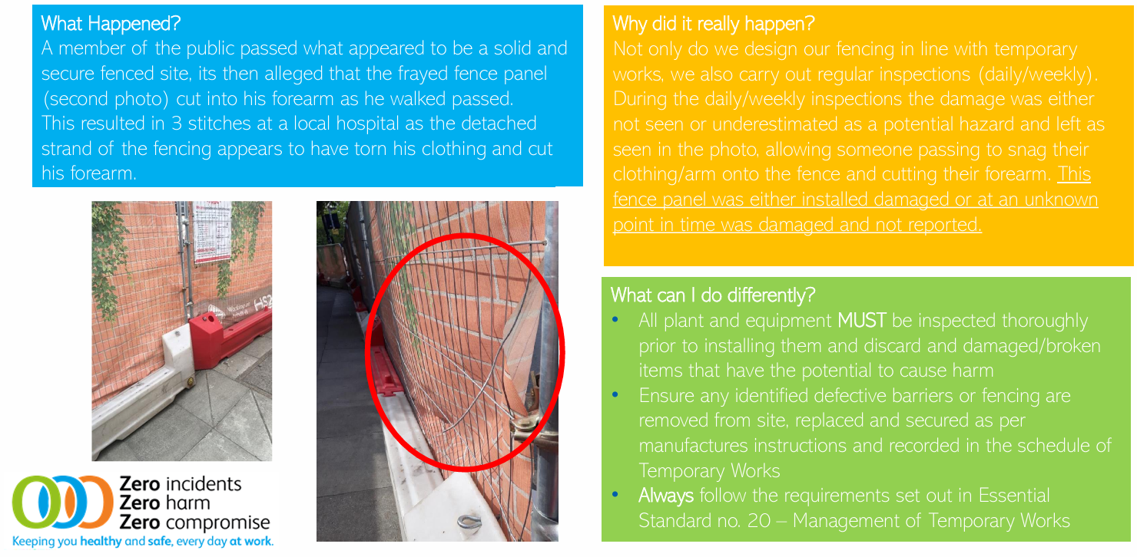
Learning Bulletin – MoP – Forearm Laceration from Fence Panel

Slide 11


Management of Site Access
For our sites and offices, there will be planned and unplanned visitors.
For sites, consider high risk areas e.g. scaffolds, excavations, networks etc.
TASK – Consider the below factors and review your visitor site induction process and site access arrangements
Management of Site Access
We must take reasonable steps to prevent unauthorised access to the site
Properly control authorised access to the site, for example all visitors should report their arrival
Provide authorised people with essential safety information and relevant site rules
Do not allow visitors and workers to walk around unaccompanied, unless they are familiar with the site and its risks

Slide 12
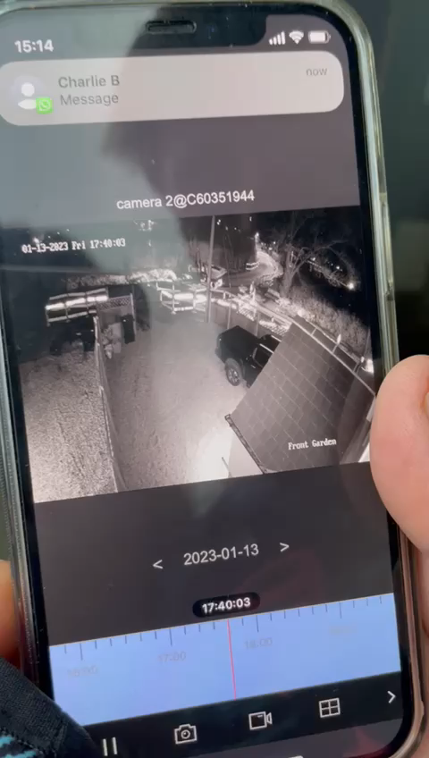
Management of Site Access
The cost of poor Site Security measures - this Non- Thames Water job depicts an incident whereby a member of the public (family or 4 – parents and 2x children) gained access to the site through unsecure barriers. The poor lighting also prohibited their ability to identify the site and so they unknowingly entered. From, this they fell down a trench causing a nasty cut to the shin requiring stitches.
Management of Site Access

Slide 13
Summary
Hazards that cause
Risk to the public
Management of Site Access
Vulnerable Groups
A dynamic risk assessment is crucial to ensure that the risks are identified and managed as works progress. This can change throughout the project and at different times of year.
Ensure site walks occur at the start of every shift and after every break to review the conditions as per the checklist covered today. Safety Observations should be logged for any action taken.
If unsure, contact your SHEQ Representative.

Slide 15
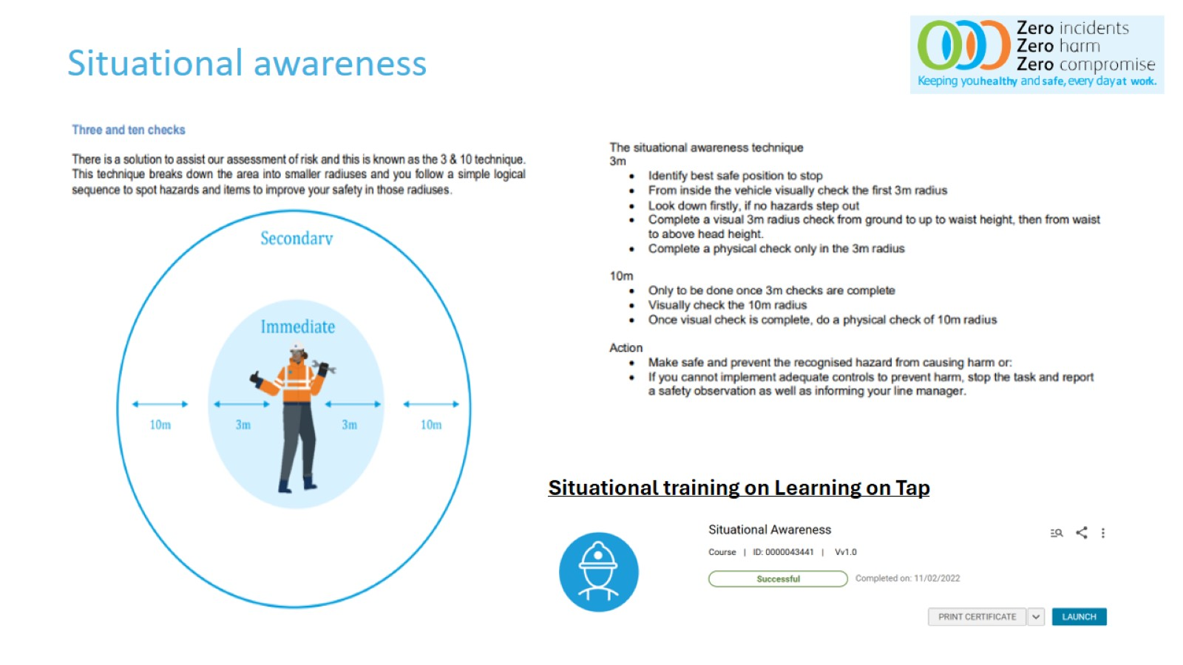
Guide – Situational Awareness

Slide 16


